Slide 1

Comparing Hydrogen and Jet-A for an N+3 Turbofan with Water Recirculation using Gradient-Based Optimization
Peter N. Atma
Andrew H.R. Lamkin, Joaquim R.R.A. Martins
Notes:
Hello, my name is Peter Atma, and I am Master’s graduate from the University of Michigan where conducted research in the MDO Lab.
In this presentation I will discuss our work developing a novel water vapor recovery system in a hydrogen-powered ultra high-bypass turbofan engine.

Slide 2
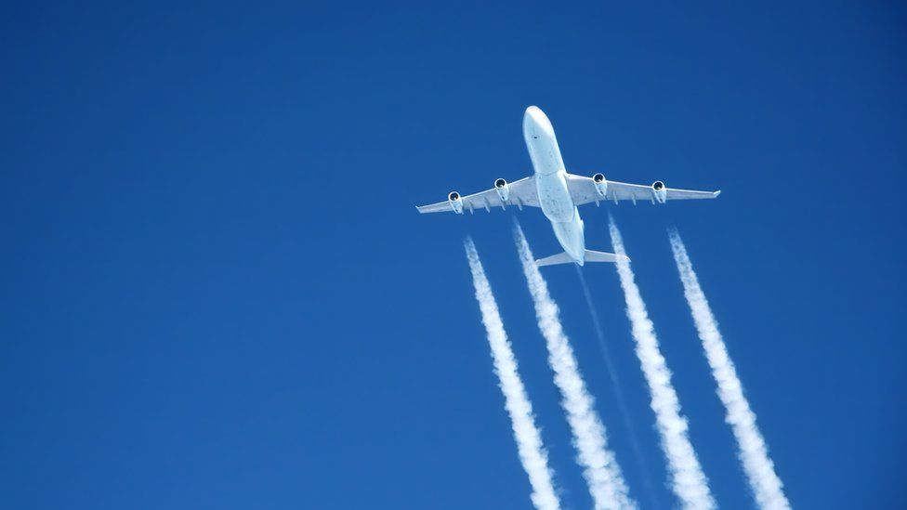
Why hydrogen?
Carbon-free alternative aviation fuel to Jet-A
Useful thermodynamic and combustion properties
https://www.bbc.com/news/science-environment-63165607
Notes:
Due to climate change, alternative aviation fuels are actively being researched to reduce carbon emissions
Hydrogen presents itself as the most viable alternative to kerosene-based fuels for long-haul flights due to being carbon free and having useful properties.

Slide 3
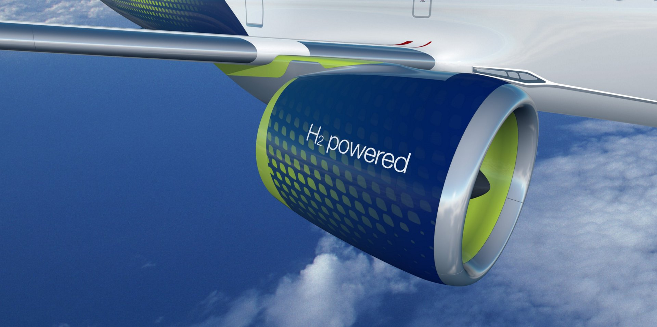
Why hydrogen?
However, hydrogen presents a few technological obstacles
https://wernerantweiler.ca/blog.php?item=2021-05-20
Notes:
Hydrogen-powered engines present a few technological obstacles to being a direct replacement for Jet-A powered engines.
Carrying and burning hydrogen introduces complexity and weight penalties because liquid hydrogen needs to be kept cold and under pressure.

Slide 4
Why water recovery?
We can use water injection to improve engine efficiency
Hydrogen combustion byproducts can be useful
Daggett, D. L., Fucke, L., Hendricks, R. C., & Eames, D. J., Water Injection on Commercial Aircraft to Reduce Airport Nitrogen Oxides, Tech. rep., NASA, March 2010.
Notes:
A NASA study found that injecting water just before the compressors augmented thrust and improved efficiency.
We can therefore use the useful thermodynamic properties and exhaust products of burning hydrogen to our advantage.
Using water recirculation can help make hydrogen-powered commercial engines viable by offsetting the penalties associated with using hydrogen.

Slide 5
Presentation Roadmap
Overview of Computational Tools
Water Recovery and Propulsion Model
Propulsion Optimization Problem
Results and Discussion
Condenser Design Space Sweep
Summary
Notes:
In the following sections of the presentation, I will present an overview of the computational tools.
Then I will explain the water recovery and propulsion models used to model the water recirculation system.
Finally, I will explain the optimization problem, discuss the results, and present a condenser design study.

Slide 6
Presentation Roadmap
Overview of Computational Tools
Water Recovery and Propulsion Model
Propulsion Optimization Problem
Results and Discussion
Condenser Design Space Sweep
Summary
Notes:
First let's look at the computational tools used in this work

Slide 7
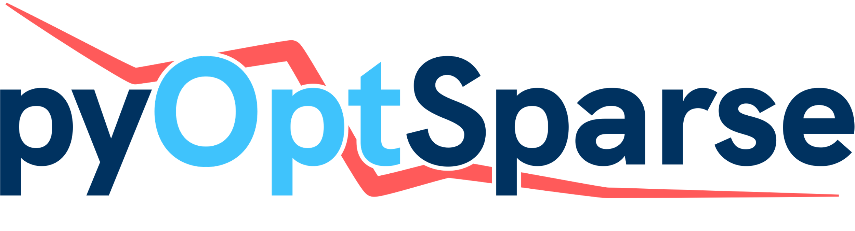
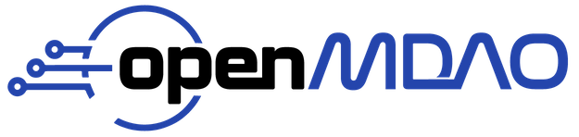
pyCycle
SNOPT
Notes:
We use OpenMDAO, an open-source platform for multidisciplinary design analysis, as the main optimization framework.
OpenMDAO supports gradient-based optimization which allows users to explore large design spaces with complex models.
For propulsion modeling, we use pyCycle which is a zero-dimensional engine cycle modeling tool written on top of the OpenMDAO framework.
pyCycle uses modular components and a chemical equilibrium analysis (CEA) solver to converge engine designs to determine performance.
The pyOptSparse framework provides a Python interface for nonlinear constrained optimizers.
We use SNOPT, which is a gradient-based sequential quadratic programming algorithm for large-scale constrained problems.

Slide 8
Presentation Roadmap
Overview of Computational Tools
Water Recovery and Propulsion Model
Propulsion Optimization Problem
Results and Discussion
Condenser Design Space Sweep
Summary
Notes:
Next, lets look at how the water recovery and propulsion models are implemented.

Slide 9
We created a water injector component in pyCycle
Injects a water flow rate and uses CEA to find the new equilibrium composition
Notes:
First, we created a water injection component in pyCycle.
This component injects a prescribed water flow rate to be added to the incoming airstream.
The CEA solver then computes the new equilibrium composition of the airstream with the added water.

Slide 10
Similarly, we created a water extractor component in pyCycle
Uses CEA to find the molar composition of water and extracts a given mass fraction
Notes:
Similarly, we created a water extractor component in pyCycle.
This component uses CEA to determine the molecular composition of the incoming flow and removes a prescribed mass fraction of that water to be recirculated upstream.
The outflow is then solved for the resulting molecular composition.

Slide 11
The injector and extractor are connected in the engine core stream
The feedback loop creates a mis-match between mass flow rates
Notes:
We then implement these two components in a turbofan engine core flow.
The feedback loop from the extractor and injector creates a mis-match between mass flow rates.
We use a nonlinear Newton solver to converge the engine mass flow rates to satisfy conservation of mass.

Slide 12
We use the NASA advanced technology N+3 ultra-high bypass ratio (UHBR) turbofan engine
Technology that could be available in the 2030—2040 timeframe
Notes:
For the propulsion model, we use the NASA advanced technology N+3 ultra-high bypass ratio turbofan engine.
This engine represents engine technology that could be available in the 2030-2040 timeframe.
This technology represents high-bypass ratios, high pressure ratio compressors and turbines, as well as increased material operating temperatures.

Slide 13
We use a Multipoint implementation of the engine
We can size the engine at the “design point” and the pass flow paths and map scalars to operate at other points
Notes:
We use a multipoint implementation of the engine where we prescribe a design point that sizes the engine and determines compressor and turbine mappings.
This allows us to consider several operating conditions in the design of the engine.
Sea Level Statis represents the static thrust requirements.
Rolling takeoff represents the cooling requirements of the engine.
Top-of-climb represents the climb performance and engine throttle ratio.
Finally, cruise represents level flight performance at the cruising altitude.

Slide 14
Presentation Roadmap
Overview of Computational Tools
Water Recovery and Propulsion Model
Propulsion Optimization Problem
Results and Discussion
Condenser Design Space Sweep
Summary
Notes:
Now we will look at the optimization problem formulation.

Slide 15
Optimization Problem
The design point was TOC and the objective function was fuel burn at CRZ
Notes:
The optimization problem was set up to converge the full multi-design point (MDP) model at each optimization iteration.
We size the engine at top-of-climb and thus use it as the design point.
Since we are interested in minimizing emissions and cost, we use fuel burn at cruise for our objective function given that cruise is usually the longest phase of flight.

Slide 16
Optimization Problem
Notes:
Here we present the design variables and constraints.
The design variables were water recovery fraction at CRZ, fan pressure ratio, LPC pressure ratio, overall pressure ratio, combustion temperature at RTO, combustion temperature ratio, and exit velocity ratio at CRZ.
The constraints were net thrust at TOC and maximum fan diameter.
The thrust constraints at the other operating conditions are set by the MDP model.
The optimization was run for both Jet-A and hydrogen with and without water recovery.

Slide 17
Presentation Roadmap
Overview of Computational Tools
Water Recovery and Propulsion Model
Propulsion Optimization Problem
Results and Discussion
Condenser Design Space Sweep
Summary
Notes:
We will now discuss the results from the optimization problems.

Slide 18
Optimization History
Notes:
Here we show the optimization history for each problem.
All four optimization problems successfully converged to the specified optimality and feasibility tolerance.
The optimizations took about 45 minutes and 18 iterations to run on a standard laptop.

Slide 19
Optimum Values
Notes:
Here we show the optimum values for each engine design.
The water recovery fraction and $T_{4,RTO}$ had opposite effects on the fuel burn, therefore we held $T_{4,RTO}$ constant to help assess the effect of water recovery
The water recovery fraction increases until the CEA model failed to converge for each fuel which is 30% for Jet-A and 17% for hydrogen.
Fan PR increases with hydrogen and water recovery as the proportion of thrust generated by the fan nozzle increases.
The OPR increases due to higher fuel-to-air ratios in core with water recovery.
Using hydrogen over Jet-A decreases $T_{4,RTO}$ due to burning at a leaner equivalence ratio.
$T_{4,ratio}$ decreases with water recovery which results in lower combustion temperatures.
Finally, we see that the thrust-specific energy consumption (TSEC) at cruise improves for both fuels with water recovery.
We use TSEC as a comparison metric since hydrogen has a much higher energy content than Jet-A.

Slide 20
Water recovery results in significant efficiency improvements
Notes:
Here we compare the optimum TSEC at cruise for each design.
Adding water recovery to each fuel results in significant efficiency improvements.
Hydrogen with water recovery has a large relative improvement compared to a standard Jet-A engine.
We can note that it would be easier to recovery water in a hydrogen engine the exhaust stream having 3 times the amount of water compared to a Jet-A engine.
Therefore, using hydrogen with water recovery would result in significant cost savings over the lifetime of the engine.

Slide 21
Presentation Roadmap
Overview of Computational Tools
Water Recovery and Propulsion Model
Propulsion Optimization Problem
Results and Discussion
Condenser Design Space Sweep
Summary
Notes:
Given these findings, we would like to map out the design space for a condenser used in this propulsion system.

Slide 22
We performed a study to explore the design space of an exhaust water condenser
We would need a condenser located before core nozzle
Notes:
To extract the water, we would need a condenser in the core stream which would incur pressure losses.
Therefore, we performed a study to determine how the engine efficiency is impacted by pressure loss at the extractor.

Slide 23
Condenser Design Space Sweep
The relative pressure drop in the exhaust stream was varied
Notes:
We varied the relative pressure loss in the duct located just before the extractor and optimized the hydrogen engine with water recovery at each value.
The red line shows the hydrogen engine without water recovery to show the efficiency limits of the water recovery system.
This figure shows the feasible design space for a condenser in which we would see efficiency gains with water recovery.
We see the maximum performance benefits up to about a 16% pressure drop.

Slide 24
Condenser Design Space Sweep
More water is recovered to compensate for pressure drop
Notes:
We also see that the optimizer designs the engine to recover more water to compensate for pressure loss.
The optimal water recovery fraction at each point was pushed to its upper limit of 17%.
Engine cycles that utilized this technology can use the thermal properties of hydrogen to condense the water and then use the heated fuel to further improve the efficiency of the engine.

Slide 25
Summary
We developed a novel closed-loop water recovery system and implemented it in a N+3 turbofan engine
We successfully optimized the engine performance with Jet-A and hydrogen with water recovery which resulted in efficiency gains
We presented the feasible design space to guide the design of a condenser to be used in this engine architecture
Notes:
In summary, we developed a novel closed-loop water vapor recovery system in a commercial turbofan engine.

Slide 26
Summary
We developed a novel closed-loop water recovery system and implemented it in a N+3 turbofan engine
We successfully optimized the engine performance with Jet-A and hydrogen with water recovery which resulted in efficiency gains
We presented the feasible design space to guide the design of a condenser to be used in this engine architecture
Notes:
We successfully optimized the engine performance with vapor recovery and showed that there are significant efficiency improvements.

Slide 27
Summary
We developed a novel closed-loop water recovery system and implemented it in a N+3 turbofan engine
We successfully optimized the engine performance with Jet-A and hydrogen with water recovery which resulted in efficiency gains
We presented the feasible design space to guide the design of a condenser to be used in this engine architecture
Notes:
Finally, we presented a feasible design space for a condenser to be used in a hydrogen-fueled engine with water recovery to obtain these efficiency improvements.

Slide 28
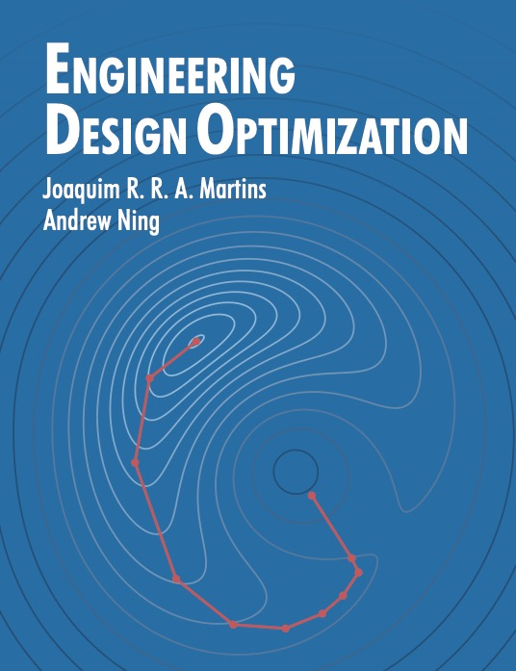
at Aviation 2023
Alasdair C. Gray, “Geometrically Nonlinear High-fidelity Aerostructural Optimization Including Geometric Design Variables”, MDO-02, Aeroelastic and Aero-Structures Optimization
Eytan Adler, “Blended wing body configuration for hydrogen-powered aviation”, Aircraft Design Optimization II
Andrew Lamkin, ”Advancements in Coupled Aeropropulsive Design Optimization for High-Bypass Turbofan Engines”, MDO-04, Aerodynamic Design and Shape Optimization III
Hannah Hajdik, “Combined systems packaging and aerodynamic shape optimization of a full aircraft configuration”, MDO-04, Aerodynamic Design and Shape Optimization III
Bernardo Pacini, “Towards Mixed-Fidelity Aero-Structural-Acoustic Optimization for Urban Air Mobility Vehicle Design”, MDO-09, Aircraft Design Optimization I
Sabet Seraj, “Minimum Trim Drag for a Three-Surface Supersonic Transport Aircraft”, MDO-03, Aerodynamic Design and Shape Optimization II
M. A. Saja Abdul-Kaiyoom, “RANS-Based Multipoint Aeropropulsive Design Optimization of an Over-Wing Nacelle Configuration”, MDO-04, Aerodynamic Design and Shape Optimization III
Alex Kleb, “Extension of a Viscous Cartesian Cut-Cell Solver to the Compressible RANS Equations”, CFD-17, CFD-APA III
https://mdobook.github.io
Notes:
Please consider viewing the talks and reading the papers written by my colleagues in the MDO Lab.
If you have a further interest in learning about numerical optimization, please consider checking out my advisor Joaquim Martin's book "Engineering Design Optimization".
A free pdf of the book is available at the link in the lower lefthand corner.

Slide 29
Backup Slides

Slide 30
Full MDA

